Slide 1
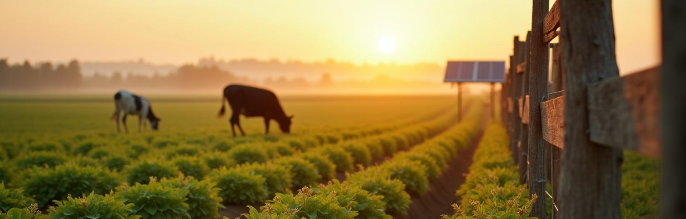
Crop Security
Safe Eco-Friendly System
TEAM MEMBERS
Sharmatha Sree P
Yuvaasree V
Dharshitha R

Slide 2
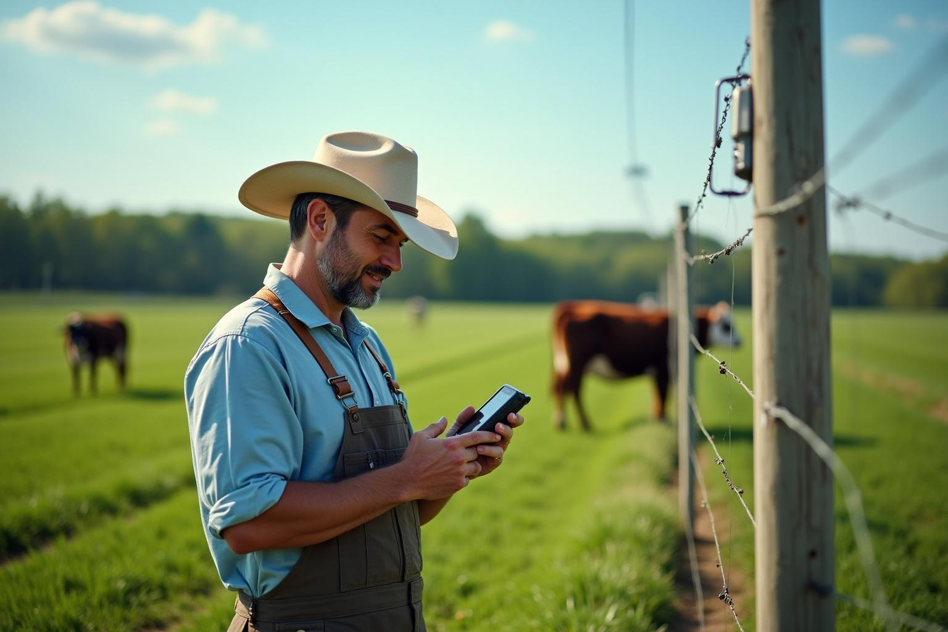
INTRODUCTION
This project offers an easy and eco-friendly way to protect crops and livestock using smart sensors and alerts. It helps farmers keep their farms safe from animals and damage with minimal cost and effort.

Slide 3
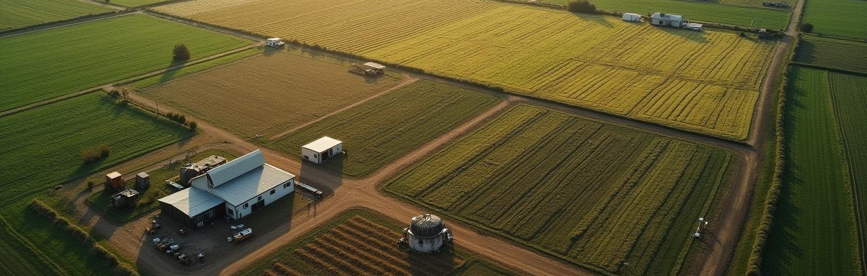
Project Overview
01

Slide 4
PROBLEM STATEMENT
Farmers face challenges protecting crops and livestock from wild animals and intruders. Traditional solutions like electrical fencing are harmful, costly, and not eco-friendly.The proposed system uses PIR and ultrasonic sensors to detect intruders. When triggered, a relay-controlled buzzer/light and LED indicator alert nearby farmers, while a GSM module sends real-time SMS notifications.A rain sensor monitors weather conditions, and the system can be powered by solar energy for autonomous use in remote areas.This solution offers a safe, sustainable, and non-lethal method to protect agriculture while promoting eco-friendly farming practices.

Slide 5
PROPOSED SOLUTION
Our system is designed to protect farmland in a safe and eco-friendly way.
It makes use of PIR sensor to detect motion, Ultrasonic sensor to verify animal or intruder presence and Rain sensor to monitor weather conditions.
All these sensors are connected to an Arduino Nano microcontroller, which acts as the brain of the system.
When any unwanted movement is detected, the Arduino triggers a relay to activate a light or alarm, and at the same time, a GSM module sends an SMS alert to the farmer’s mobile phone.
This ensures that farmers are informed immediately and can take quick action.
The system is low-cost, safe for animals and humans, and contributes to sustainable farming practices.

Slide 6
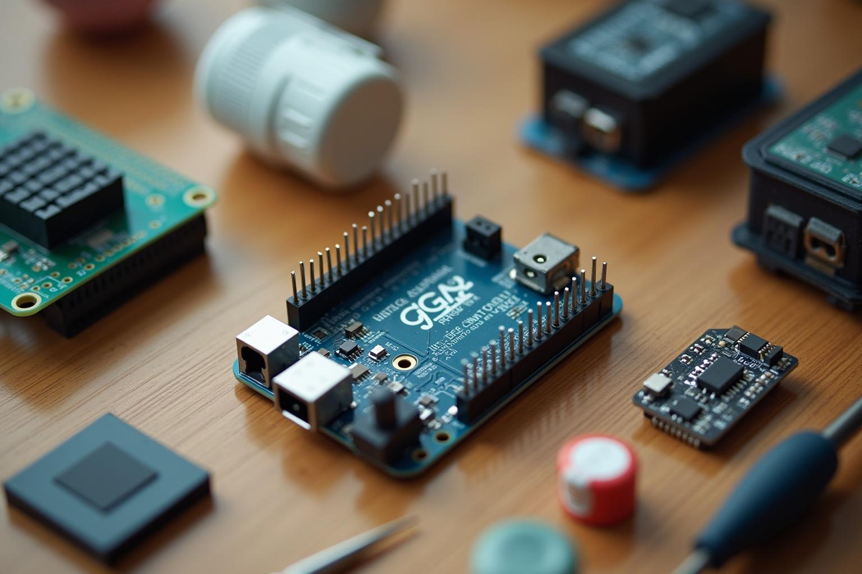
COMPONENTS OVERVIEW
Microcontroller (Arduino Nano): Central unit that processes sensor inputs and controls outputs
Motion Detection Sensors: Detect movement of animals or intruders.
Relay Module: Works as a switch to activate deterrent devices safely.
Deterrents (Buzzer/Light): Produce sound or light signals to scare away animals harmlessly.
GSM Module: Sends real-time SMS alerts to farmers for quick action.
Rain Sensor: Monitors rainfall and provides environmental data.
Power Supply (Battery): Ensures reliable and eco-friendly operation.
Supporting Hardware: Includes resistors, wires, connectors, and enclosures for safe setup.

Slide 7
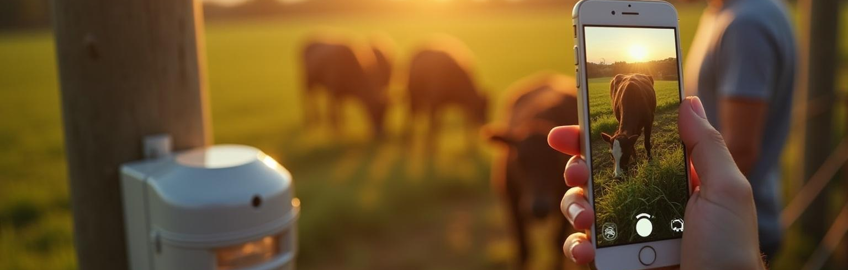
System Operation and Benefits
02

Slide 8
WORKING PRINCIPLE FLOW
PIR Sensor continuously monitors for any motion near the field.
If motion is detected → Ultrasonic Sensor verifies the distance of the object (to confirm animal/intruder).
If verification is positive → Arduino activates the Relay, which switches ON a light/alarm to scare away intruders.
Simultaneously, the GSM Module sends an SMS alert to the farmer’s mobile phone.
Rain Sensor keeps monitoring the weather and can also be used for automatic irrigation or weather alerts.
Once the intruder/animal leaves → sensors reset and the system goes back to monitoring mode.

Slide 9
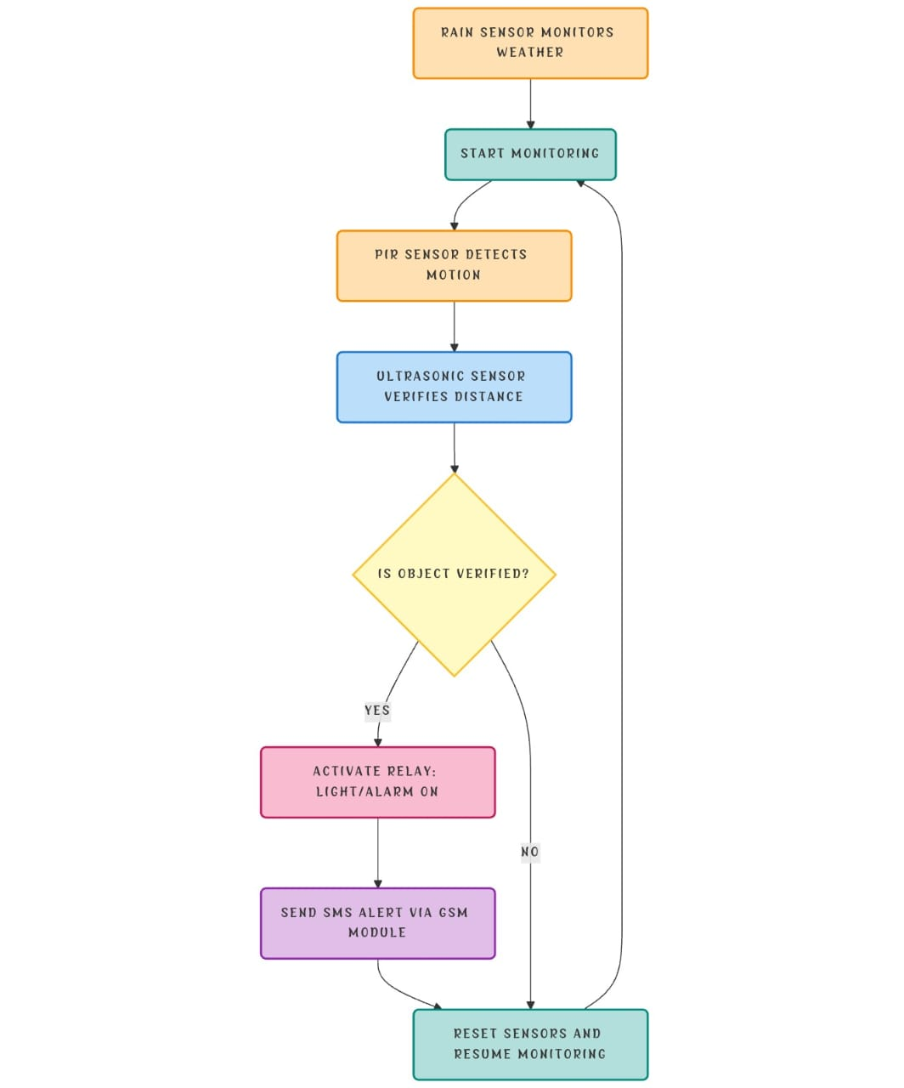

Slide 10
KEY ADVANTAGES
Safe & Humane: Protects crops and livestock without harming animals or humans.
Eco-Friendly: Operates on renewable energy sources like solar power.
Cost-Effective: Reduces expenses compared to traditional fencing or manual guarding.
Real-Time Alerts: Sends instant notifications to farmers, enabling quick response.
Autonomous Operation: Works continuously with minimal human intervention.
Reliable in Remote Areas: Functions even in off-grid locations with poor power supply.
Multi-Functional: Provides both intruder detection and weather monitoring.
Promotes Sustainable Farming: Encourages modern, ethical, and environment-friendly practices.

Slide 11
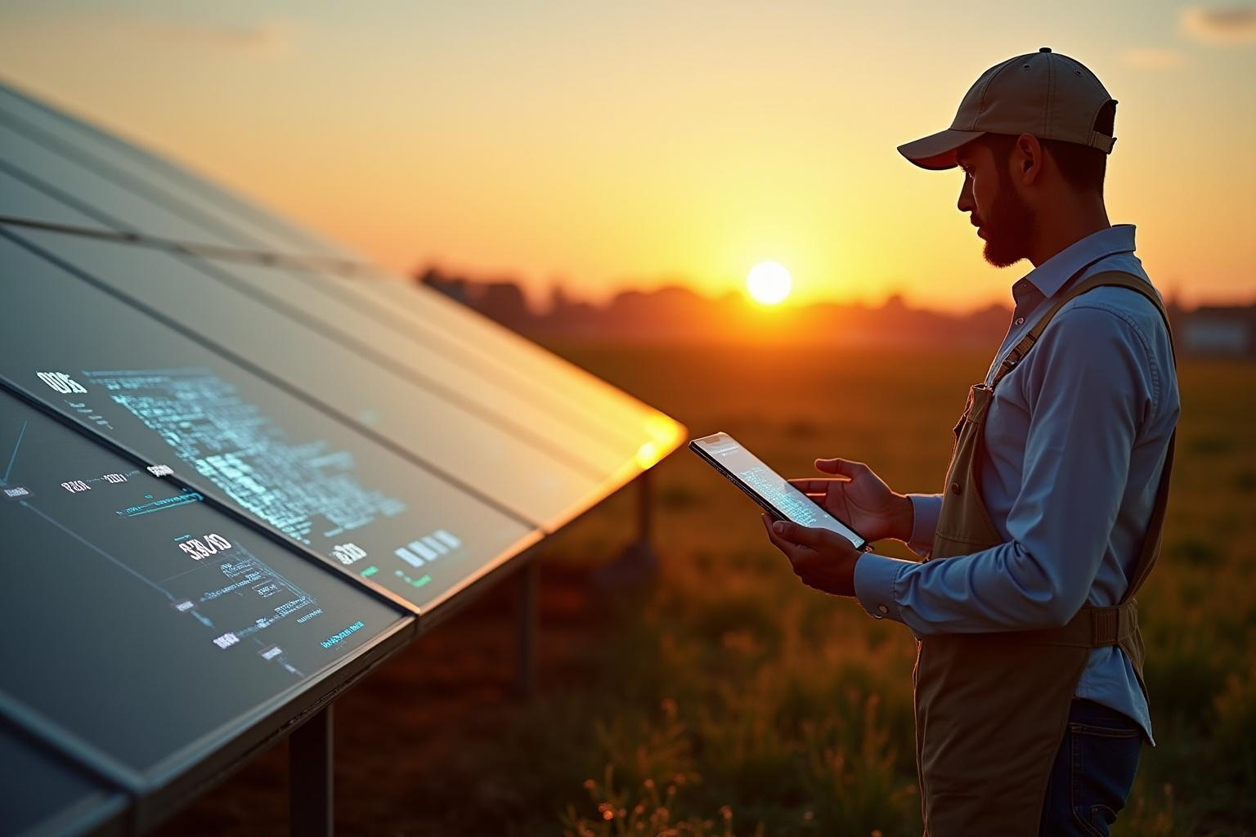
FUTURE ENHANCEMENTS
Mobile App Integration: A dedicated smartphone app can provide real-time notifications, remote control of deterrent devices, and live monitoring of the farm.
AI & Machine Learning: Smart algorithms can analyze sensor data to differentiate between humans, large animals, and false triggers (like wind or small objects).
Camera Surveillance: Adding cameras for image or video capture will help farmers visually confirm intrusions and gather evidence when needed.
Wireless Networking: Linking multiple systems together across large farms can provide wide coverage and coordinated protection.

Slide 12
CONCLUSION
The Safe and Eco-Friendly Crop & Livestock Security System addresses one of the most pressing challenges in agriculture—protecting crops and livestock without harming animals or the environment.
By combining modern technology with sustainable practices, the system offers:Real-time detection and alerts that enable farmers to respond quickly.Non-lethal deterrents that keep animals and intruders away safely.Renewable energy operation, making it ideal for rural and remote areas.
A cost-effective and low-maintenance design, accessible to farmers of all scales.This project not only protects farmers’ livelihoods but also supports sustainable farming, food security, and environmental conservation.
It is a step toward building a future where technology and agriculture work hand in hand to ensure safety, productivity, and eco-friendliness.

Slide 13
Thank You

